Slide 1
Arithmetic Hardware

Slide 2
Introduction
Adders
Half
Full
Ripple-Carry
Carry-Lookahead
Carry-Select
Arithmetic Logic Unit

Slide 3
1-Bit Half Adder
Sum = A’B + AB’
Cout = AB
A | B | Sum | Cout
0 | 0 | 0 | 0
0 | 1 | 1 | 0
1 | 0 | 1 | 0
1 | 1 | 0 | 1

Slide 4
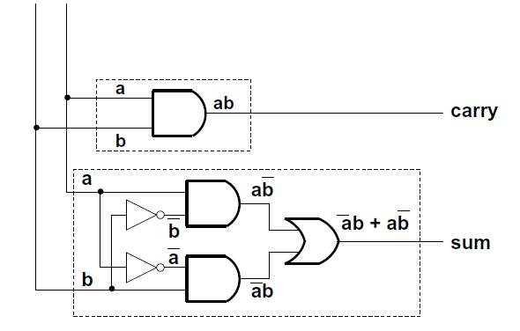
1-Bit Half Adder

Slide 5
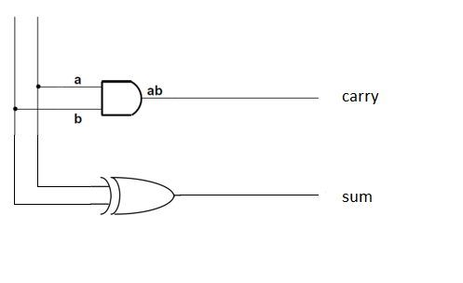
1-Bit Half Adder
Sum = A’B + AB’
= A XOR B

Slide 6
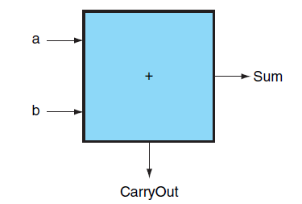
1-Bit Half Adder
Block Diagram

Slide 7
1-Bit Full Adder
Sum = A XOR B XOR Cin
Cout = AB + ACin + BCin
Inputs |  |  | Outputs |  | Comments
A | B | Cin | Cout | Sum
0 | 0 | 0 | 0 | 0 | 0+0+0=00
0 | 0 | 1 | 0 | 1 | 0+0+1=01
0 | 1 | 0 | 0 | 1 | 0+1+0=01
0 | 1 | 1 | 1 | 0 | 0+1+1=10
1 | 0 | 0 | 0 | 1 | 1+0+0=01
1 | 0 | 1 | 1 | 0 | 1+0+1=10
1 | 1 | 0 | 1 | 0 | 1+1+0=10
1 | 1 | 1 | 1 | 1 | 1+1+1=11

Slide 8
1-Bit Full Adder
Standard approach
6 gates
2 XORs, 2 ANDs, 2 ORs
A
B
Cin
S
A
B
Cin
Cout
A
B
Cout = A B + Cin (A xor B) = A B + B Cin + A Cin

Slide 9
1-Bit Full Adder
Alternative implementation
5 gates
half adder is an XOR gate and AND gate
2 XORs, 2 ANDs, 1 OR
A
Sum
A xor B
A xor B xor Cin
Sum
Half Adder
Half Adder
B
A B
Cin (A xor B)
Cout
Cout
Cin
Cout

Slide 10
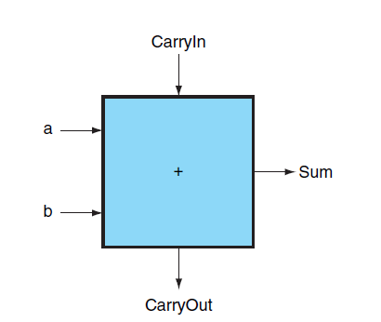
1-Bit Full Adder

Slide 11
Ripple-Carry Adder
To add binary numbers of lengths greater than 1, we cascade one bit adders together.
A3
B3
A2
B2
A1
B1
A0
B0
A
B
A
B
A
B
A
B
Cout
Cin
Cout
Cin
Cout
Cout
Cin
0
Cin
Sum
Sum
Sum
Sum
S3
S2
S1
S0
Overflow

Slide 12
Ripple-Carry Adder: Example
3+2 = 5
0011 + 0010 = 0101
0
A3
B3
0
0
A2
B2
0
1
A1
B1
1
1
A0
B0
0
A
B
A
B
A
B
A
B
0
0
1
0
Cout
Cin
Cout
Cin
Cout
Cout
Cin
0
Cin
Sum
Sum
Sum
Sum
S3
S2
S1
S0
0
1
0
1
Overflow
0

Slide 13
Ripple-Carry Adder: Subtraction
Use adders to subtract with 2s complement representation
A – B = A + (– B) = A + B' + 1
A3
B3
B3'
A2
B2
B2'
A1
B1
B1'
A0
B0
B0'
0
1
Sel
0
1
Sel
0
1
Sel
0
1
Sel
A
B
A
B
A
B
A
B
Cout
0 = Add 1 = Subtract
Cin
Cout
Cin
Cout
Cout
Cin
Cin
Sum
Sum
Sum
Sum
S3
S2
S1
S0
Overflow

Slide 14
Ripple-Carry Adder: Subtraction
7 – 6 = 1
0111 – 0110 = 0001
0
0
1
1
1
0
1
1
0
1
0
1
A3
B3
B3'
A2
B2
B2'
A1
B1
B1'
A0
B0
B0'
0
1
Sel
0
1
Sel
0
1
Sel
0
1
Sel
0
1
1
0
1
0
1
1
A
B
A
B
A
B
A
B
1
1
1
1
1
Cout
Cin
Cout
Cin
Cout
Cout
Cin
Cin
1
Sum
Sum
Sum
Sum
S3
S2
S1
S0
0
0
0
1
Overflow
0

Slide 15
Ripple-Carry Adder: Disadvantage
Long Delay
Carry bit may have to propagate from LSB to MSB
Worst case delay for n-bit adder = 2n gate delays
CIn0
A0
1-bit
2 gates/level
Result0
CIn
B0
CIn1
COut0
A
A1
1-bit
Result1
n
B1
CIn2
COut1
A2
1-bit
Result2
B2
B
COut
CIn3
COut2
A3
1-bit
Result3
B3
COut3

Slide 16
Ripple-Carry Adder: Disadvantage
Long delay due to the propagation of carry from low to high order stages
Cin
4 stage
adder
@0
@0
A
@1
@N+1
B
A0
S0 @2
@N
Cin
Cout
B0
C1 @2
@0
@0
A
@N+2
B
@1
A1
S1 @3
B1
C2 @4
late
arriving
signal
two gate delays
to compute Cout
A2
S2 @5
B2
C3 @6
A3
S3 @7
B3
Cout @8

Slide 17
Ripple-Carry Adder
Long delay due to the propagation of carry from low to high order stages
The key to speeding up addition is determining carry values sooner.

Slide 18
Carry-Lookahead Logic
Carry generate: Gi = Ai Bi
Must generate carry when A = B = 1
Carry propagate: Pi = Ai xor Bi
Carry-in will equal carry-out here

Slide 19
Carry-Lookahead Logic
Sum and Cout can be re-expressed in terms of generate/propagate:
Sumi = Ai xor Bi xor Ci = Pi xor Ci
Ci+1 = Ai Bi + Ai Ci + Bi Ci = Ai Bi + Ci (Ai + Bi) = Ai Bi + Ci (Ai xor Bi) = Gi + Ci Pi

Slide 20
Carry-Lookahead Logic
Assume we have a 4-bit adder:
C1 = G0 + P0 C0
C2 = G1 + P1 C1 = G1 + P1 G0 + P1 P0 C0
C3 = G2 + P2 C2 = G2 + P2 G1 + P2 P1 G0 + P2 P1 P0 C0
C4 = G3 + P3 C3 = G3 + P3 G2 + P3 P2 G1 + P3 P2 P1 G0 + P3 P2 P1 P0 C0
Each of the carry equations can be implemented with two-level logic
All inputs are now directly derived from data inputs and not from intermediate carries
this allows computation of all sum outputs to proceed in parallel

Slide 21
Carry-Lookahead Implementation
Adder with propagate and generate outputs
Ai
Pi @ 1 gate delay
Bi
Ci
Si @ 2 gate delays
increasingly complex logic for carries
Gi @ 1 gate delay
C0
C0
C0
P0
C1
P0
P0
G0
P1
P1
P2
P2
G0
P3
C0
P1
G0
P0
P2
P1
P1
G1
C3
P2
G0
P2
P3
P1
C2
G1
G2
P2
G1
P3
G2
C4
P3
G3

Slide 22
Carry-Lookahead Implementation
Carry-lookahead logic generates individual carries
Cin
Sums computed much more quickly in parallel
However, cost of carry logic increases with more stages
Cin
A0
S0 @2
B0
C1 @3
A0
S0 @2
B0
C1 @2
A1
S1 @4
B1
C2 @3
A1
S1 @3
B1
C2 @4
A2
S2 @4
B2
C3 @3
A2
S2 @5
B2
C3 @6
A3
S3 @4
B3
C4 @3
C4 @3
A3
S3 @7
B3
Cout @8

Slide 23
Partial Carry Lookahead Adder
Very expensive to build “full” carry lookahead adder
Imagine the length of the equation for Cin31!
In practice:
Connect several N-bit lookahead adders
Example: four 8-bit carry lookahead adders can form a 32-bit partial carry lookahead adder
A[31:24]
B[31:24]
A[23:16]
B[23:16]
A[15:8]
B[15:8]
A[7:0]
B[7:0]
8
8
8
8
8
8
8
8
8-bit Carry
Lookahead
Adder
C24
8-bit Carry
Lookahead
Adder
C16
8-bit Carry
Lookahead
Adder
C8
8-bit Carry
Lookahead
Adder
C0
8
8
8
8
Result[31:24]
Result[23:16]
Result[15:8]
Result[7:0]

Slide 24
Carry-Select Adder
Redundant hardware to make carry calculation go faster
Compute two high-order sums in parallel while waiting for carry-in
One assuming carry-in is 0 and another assuming carry-in is 1
Select correct result once carry-in is finally computed
C8
4-bit adder [7:4]
1
adder high
C8
4-bit adder [7:4]
0
adder low
five 2:1 mux
1
0
1
0
1
0
1
0
1
0
C4
4-Bit Adder [3:0]
C0
C8
S7
S6
S5
S4
S3
S2
S1
S0

Slide 25
Arithmetic Logic Unit
The Arithmetic Logic Unit (ALU) is the brawn of the computer
Performs arithmetic operations (addition, subtraction)
Performs logical operations (AND, OR, NOR)
Performs logical comparisons (Less Than, Equal To)

Slide 26
Arithmetic Logic Unit
We will need (at least) a 32-bit ALU
Connect 32 1-bit ALUs together

Slide 27
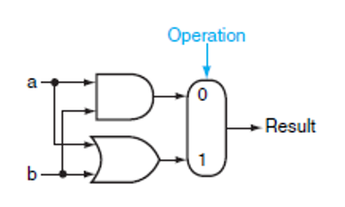
AND, OR
Uses: AND gate, OR gate, 2:1 mux

Slide 28
Addition
Add a 1-bit full adder

Slide 29
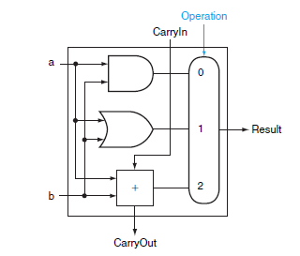
Addition
This 1-bit ALU will perform AND, OR, and ADD

Slide 30
Subtraction
(A – B) is equivalent to A + (–B)
Take 2’s complement of B and add A
2’s Complement: invert every bit and add 1
To invert B
Add a 2:1 mux that chooses between b and b’
To add 1
Set the CarryIn to 1 instead of 0

Slide 31
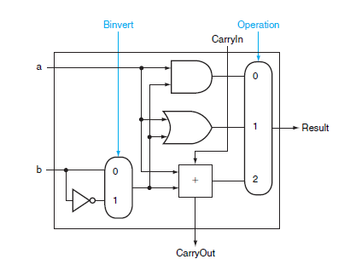
Subtraction

Slide 32
NOR
NOR = NOT (A OR B)
= (A + B)’
= A’*B’
= A’ AND B’
We already have an AND gate and an inverter for B
Add an inverter for A

Slide 33
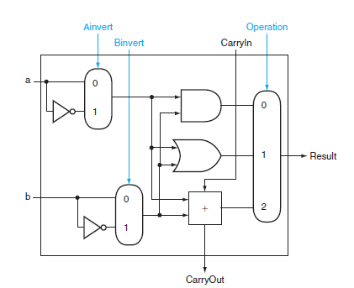
NOR

Slide 34
Set on Less Than
Set on Less Than (slt) is a MIPS instruction
For inputs A and B it produces 1 if A<B, 0 otherwise
All bits are set to zero except for the least significant
Least significant bit determined by the result of A<B

Slide 35
Set on Less Than
For our ALU to perform this operation we need:
A bigger mux
Input for the slt (called Less)
Method for determining if A<B

Slide 36
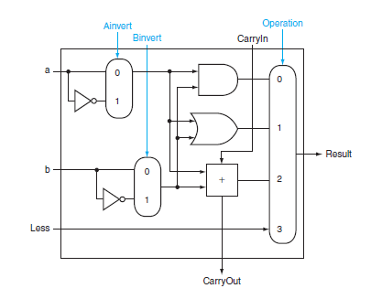
Set on Less Than
Bits 1-31: Less = 0

Slide 37
Set on Less Than
A < B
A-B < 0
Subtract and check the sign of the result
1 if less than 0
0 otherwise

Slide 38
Set on Less Than
Bits 1-31: Less = 0
Bit 0: sign bit of A-B

Slide 39
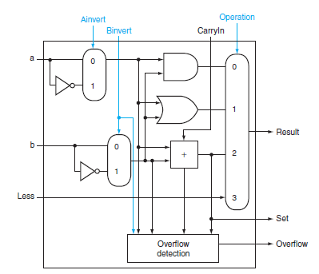
Set on Less Than

Slide 40
Equal To
A = B
A-B = 0
Subtract and check to see if all bits are zero
NOR all bits

Slide 41
Equal To
Zero Detection Logic is just a NOR gate
Output true (1) only if all inputs zero
CIn0
A0
1-bit
ALU
Result0
B0
CIn1
COut0
A1
1-bit
ALU
Result1
B1
Zero
CIn2
COut1
A2
1-bit
ALU
Result2
B2
CIn3
COut2
A3
1-bit
ALU
Result3
B3
COut3

Slide 42
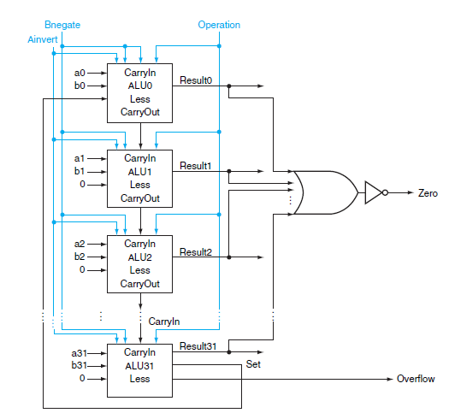
A 32-Bit ALU
Connect:
31 ALUs without overflow detection
1 ALU with overflow detection (MSB)

Slide 43
A 32-Bit ALU
Set on Less Than:
Less = 0 Bits 1-31
Less = sign bit Bit 0

Slide 44
A 32-Bit ALU
Subtraction:
Both CarryIn and Binvert are 1
Combine into 1 signal “Bnegate”

Slide 45
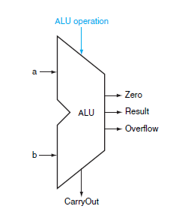
A 32-Bit ALU
Universal symbol for ALU

